Slide 1
Introducing Our New Boat Handling Course and Seminar Series
Notes:
America’s Boating Club has a new Boat Handling course, and seminar series designed to replace our Seamanship curriculum. Seamanship is currently the most popular course we offer, after America’s Boating Course. 60% of active members have taken Seamanship, and many squadrons offer it to non-members as well. The new Boat Handling course has been designed with today’s recreational boater in mind and uses modern tools to facilitate instruction and learning. We hope it will help you reach more people, grow your educational programs, and grow your membership.

Slide 2
What’s Included
What’s new
For students
For instructors
Overview of learning objectives
Making the most of the course
Notes:
In this presentation, we’ll share what’s new for students and instructors and some examples of how the new features are used in the Boat Handling course to facilitate instruction and learning.
We’ll present the learning objectives for each of the six topic areas for the course.
Lastly, we will give you some hints on how to make the most of this course.
Let’s get started.

Slide 3
What’s New
Notes:
Let’s see what’s new…

Slide 4
What’s New?
Better content for today’s recreational boater
Builds on ABC, eliminates redundant material
Need-to-know knowledge
Essential skills – what, how, when to use them
Better instructor materials
Better visuals and media
Designed to support more flexible delivery
Instructor support aligns with best practice
Better alignment with on-the-water training
Notes:
What’s new?
Boat Handling not only updates our Seamanship curriculum, but also responds to feedback received from squadrons and students especially from the 2018 Pilot Program. Specifically, Chapters 1 and 2 of Seamanship 2016 have been eliminated as they duplicated material adequately covered in America’s Boating Course. Although the remainder of the seminars cover material contained in ABC, it is presented in greater depth and breadth and gives the students knowledge they need as new boaters.
New student guides have been prepared and new PowerPoint presentations have been developed using the latest in educational media such as videos and animations of critical skills that the new boater needs.
Many of the seminars tie in directly with the skills being taught in our current Hands-On Training program and evaluated for Boat Operator Certification–Inland Navigator certification.
For students who are looking to fulfill the advanced grade requirements, completion of all six seminars of the course and passing a new, standard closed-book exam will earn them the Seaman grade. Credit for the individual seminars that members actually attend will also be given when the exam is graded. See the Instructor Guide for the procedures to report attendance when submitting exams for grading.

Slide 5
New, Improved Features
Duplicative material removed
Need-to-know information updated, expanded
Slides have been rebranded with the America’s Boating Club logos and standard look and feel.
New delivery tools added
Upgraded graphics
Embedded videos, usable without internet
Updated photos
New animations
Notes:
In addition to removing duplicative material from America’s Boating Course and updating the remainder of the information that new boaters need to know, the Boat Handling Committee has used new and innovative ways to get the information to the students in ways that will keep their interest and enhance their understanding and the look and feel of the slides highlight our new America’s Boating Club brand.
Let’s take a look…

Slide 6
Better Student Materials
Student materials
New eBook student guide with six parts
Clear learning objectives
Most important content first in each topic
Clear how-to guidance on need-to-know skills
Student guides include terms from our Nautical Glossary
Rules of the Road Student Guide supplements the USCG Navigation Rules and Regulations Handbook
Notes:
The Boat Handling Course consists of six totally rewritten topic areas. Each topic area is presented in its own chapter in the course student guide. Each seminar will have its own student guide with exactly the same content as the similar chapter in the course.
Each topic has clear learning objectives, and the content begins with the most important content. Students will acquire essential knowledge and be coached on how to perform essential skills and to know when to use them.
The student guide for the course includes America’s Boating Club’s nautical glossary with terms associated with all six topic areas. Each seminar guide includes the glossary associated with that specific topic.
For the Rules of the Road seminar, we continue to use the USCG Navigation Rules and Regulations Handbook, which is available as a free download from the U.S. Coast Guard but a separate student guide has been created as a result of feedback from the field that parallels the topic information presented in the PowerPoint.

Slide 7
Better Instructor Materials
Six new PowerPoint presentations
Clear learning objectives
Clear guidance on boat handling skills
Great visuals make the course come alive
Videos, animations, new graphics
Instructor support
Better review questions
Instructor guide
Single downloadable Instructor Kit
Notes:
Each seminar has a new PowerPoint presentation that uses today’s advanced learning media to enhance the student experience. The videos and animations are outstanding and with updated graphics and photos, the course really looks new and fresh.
Each PowerPoint presentation includes full written narration for each slide that can be used to support our Americans With Disability Act commitments or can be used by the instructor to help them develop their own delivery techniques.
The course includes better review questions that will help instructors check students’ understanding, and an instructor guide on how to use the instructor materials is available as a course download on the Educational Department website.
To simplify squadron preparation for presenting the full spectrum of the Boat Handling curriculum a single downloadable instructor kit has the full student guide,, each of the six individual seminar student guides and the six PowerPoint presentations. Squadrons that purchased the Boat Handling 2018 Instructor kit will receive one free download of the 2019 instructor kit.

Slide 8
Instructor Guide
Instructor guides provide additional information for the instructor:
Learning objectives that detail what the student will learn upon completion of the seminar
Hints on how to get the most out of the PowerPoint
Suggestions for student exercises
Seminar-specific information
Notes:
The course is supported by an instructor guide that will provide the instructor with the learning objectives, hints on how to get the most out the PowerPoint, suggestions for student exercises, and other information to help the instructor prepare to teach each seminar.

Slide 9
Basic Principles of Planing
Notes:
To facilitate student comprehension, each PowerPoint is organized into several subtopics. Each subtopic begins with a white title slide. This tells the student that a new topic is beginning, so that they can be prepared to learn. You have already experienced title slides with this presentation.

Slide 10
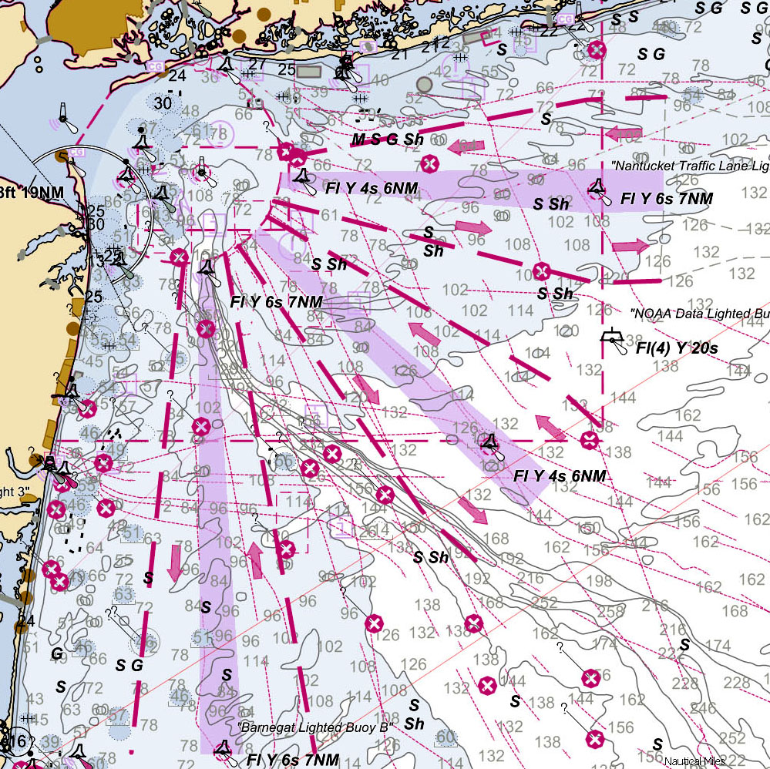
Traffic Separation Schemes
Inshore
traffic zone
Eastern
Approach
Navigation
Aid
Inbound
Separator
Outbound
Inshore
traffic zone
Southeastern
Approach
Southern
Approach
Inbound
Cross traffic
zones at
right angles
Separator
Outbound
Notes:
Here is the new graphic of a Traffic Separation Scheme. Not only does the graphic show the components of the scheme more prominently, it is animated to show just how such a scheme works.

Slide 11
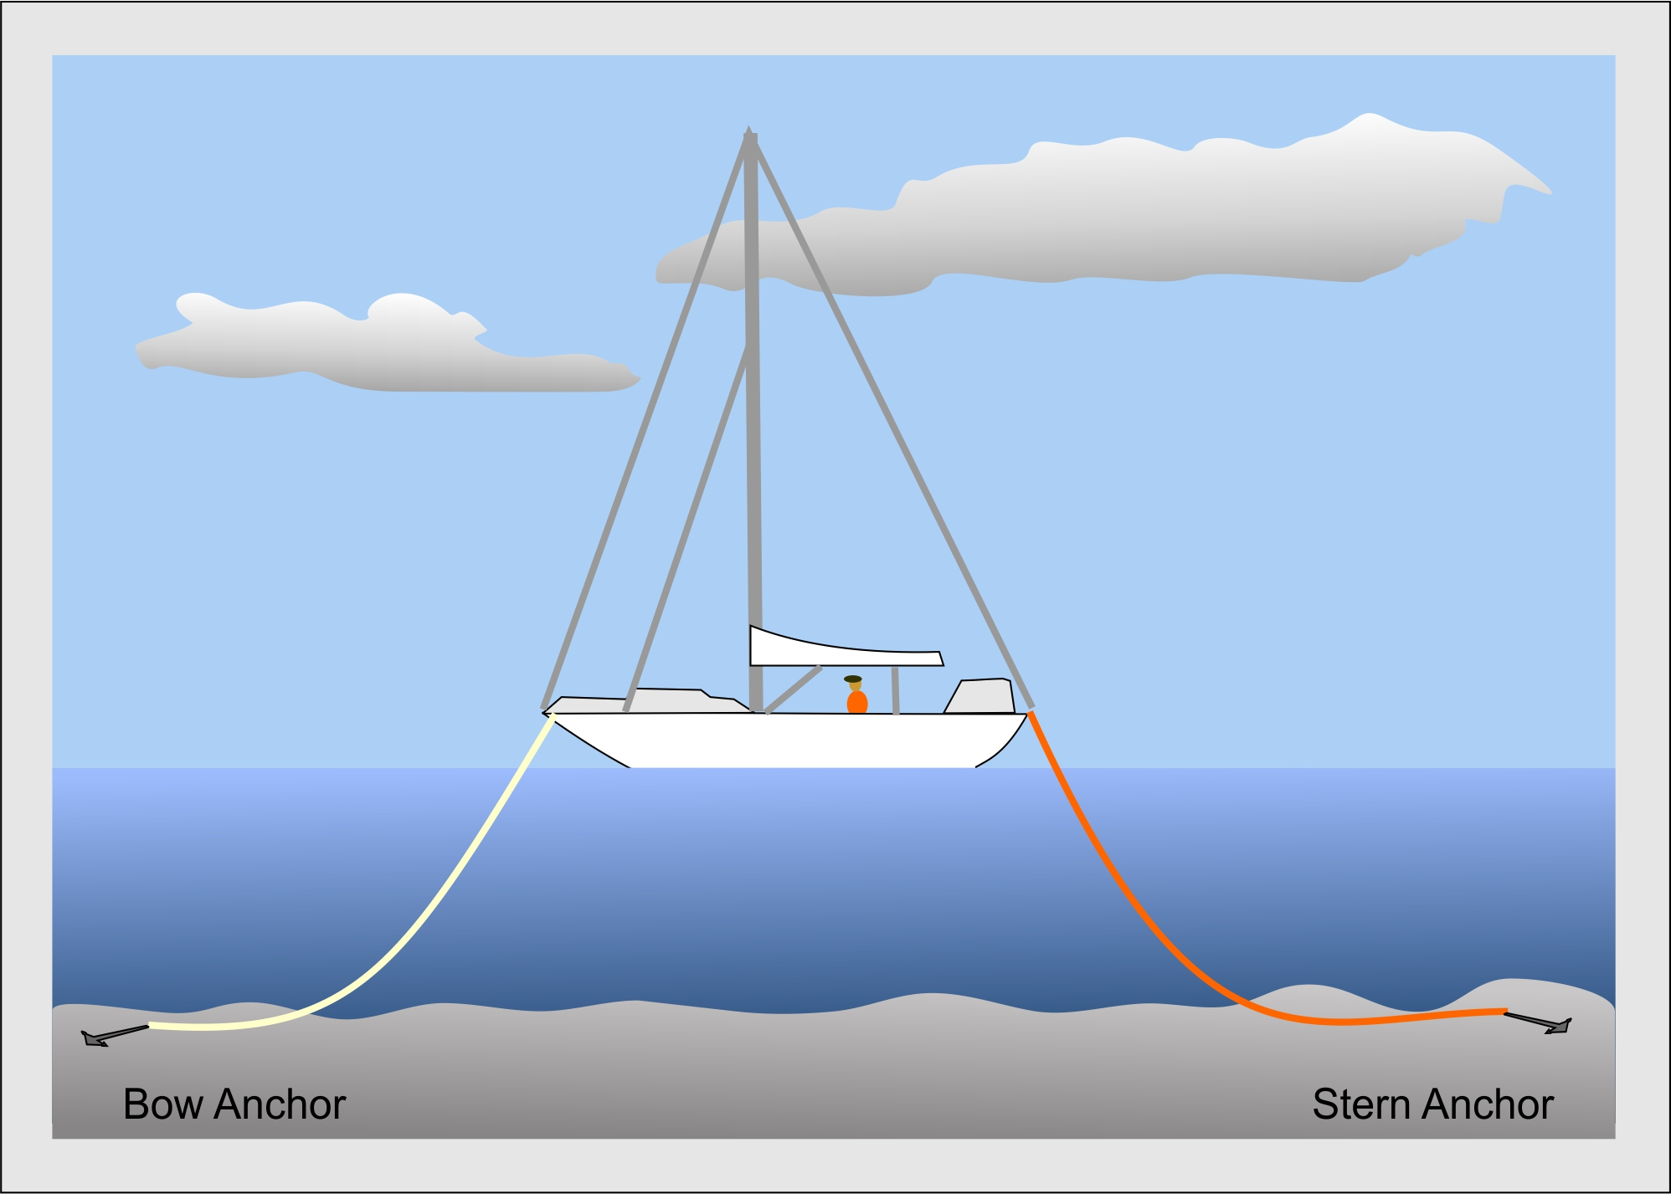
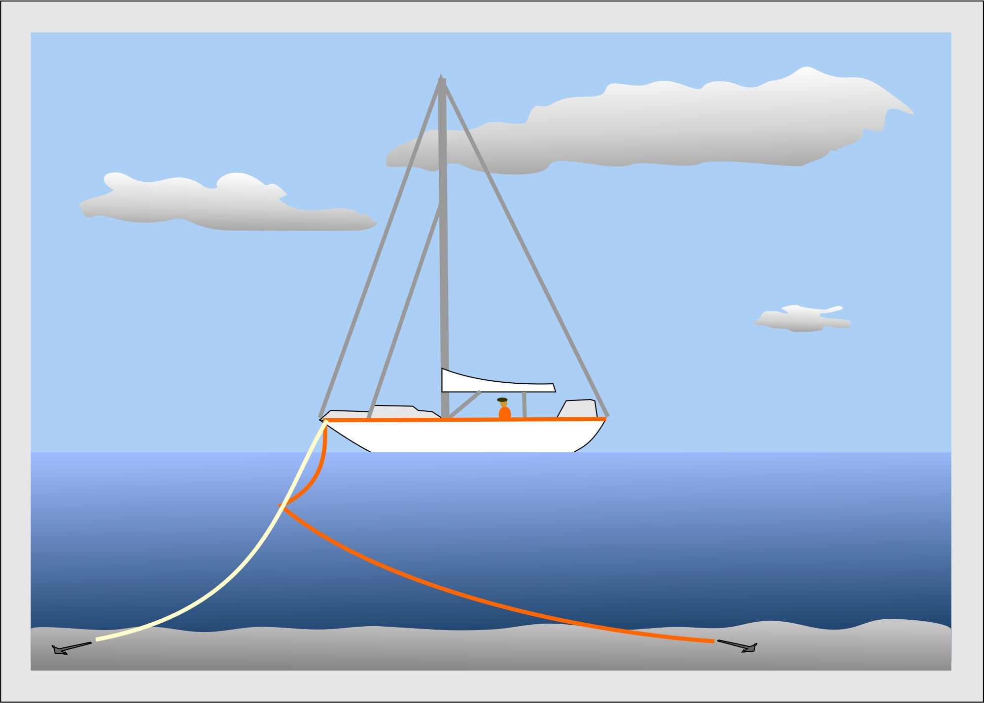
Setting Two Anchors
Fore-and-aft anchoring Bahamian mooring
Notes:
We’ve used more consistent depictions of boats when discussing related material.

Slide 12
Departing from the Dock
Notes:
Live-action videos from our Boat Operator Certification program and from America’s Boating Channel have been used to demonstrate and facilitate student understanding of concepts and skills. This one is from our BOC program.

Slide 13
MOB Maneuvers Quick-Stop Method
MOB
Turn hard over toward MOB side
Approach MOB after completing 360°circle
Reduce speed
Stop engine
Pick up MOB
Notes:
Traditional PowerPoint animations have been updated to work on all computers.

Slide 14
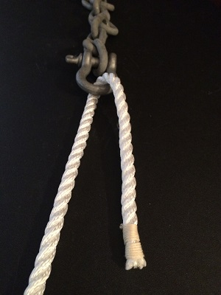
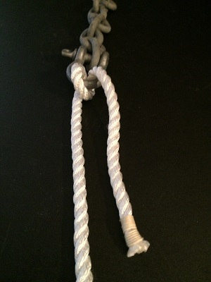
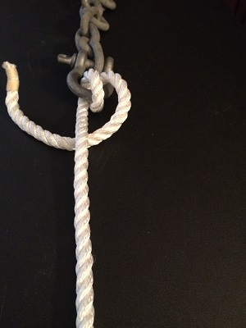
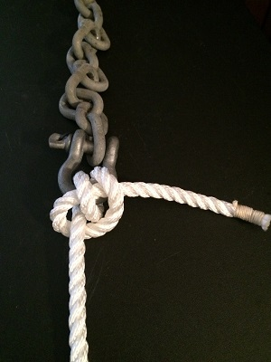
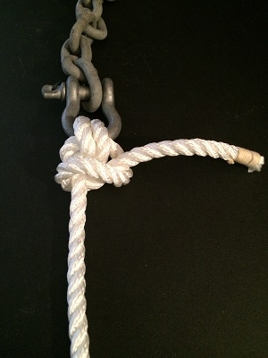
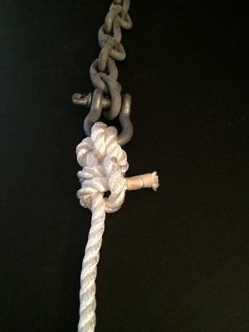
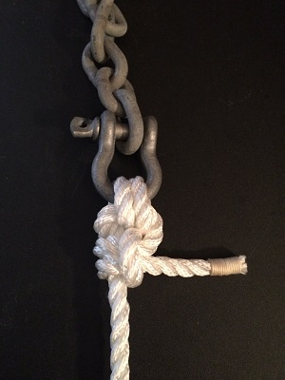
Anchor Bend
Take round turn around anchor ring or shackle
Make turn around standing part
Feed bitter end through center of round turn
Make two half hitches around standing part
Snug up the bend
Notes:
Where necessary, slides provide a step-by-step approach to promote student understanding of the skills.

Slide 15
Anchor Bend (2)
Notes:
Since learners sometimes need different ways for the material to be presented, optional methods of presentation are provided. Here is same anchor bend that was tied in the previous slide, shown in 3-D animation.

Slide 16
Anchor Bend (3)
Take round turn around anchor ring or shackle
Make turn around standing part
Feed bitter end through center of round turn
Make two half hitches around standing part
Snug up the bend
Notes:
We are even going to provide additional teaching aids such as this version of the anchor bend for left-handed students who otherwise could have difficulty visualizing how to tie the knot.

Slide 17
Review Questions
While operating a boat with an outboard engine, trimming the engine in too far may cause the boat to:
take on water over a low stern.
stern steer.
bow steer and perhaps take on water.
do nothing, since you can’t trim in too far.
Notes:
The final slides in each seminar provide a final review of the material presented and are the same as the Review Questions in the Student Guide. Each slide shows the question and the possible answers.
Review questions have also been placed (and hidden) at the end of each topic, so instructors may use them to check understanding before moving on to the next topic.
Instructors should use the questioning techniques presented in the USPS Instructor Development Course to elicit student thinking and response to each question. When students have responded, left-clicking on the mouse (or advancing on a remote control) will display the arrow pointing to the correct answer.

Slide 18
Learning Objectives
Notes:
Each of the six “seminars” has clear learning objectives, which we’ll review in a moment.
Instructors are encouraged to use the teaching principles from in the Instructor Development course to help students achieve the knowledge and skills outlined in these objectives.
The local squadron instructor is the key to successful student learning. Your ideas on how to achieve the objectives presented here are of great value to future students throughout America’s Boating Club.
Other squadrons can benefit from your success. The national Educational Department wants to hear from you… to know how you made the material come even more alive, how you promoted your students understanding of the course concepts and ability to apply them, how you blended classroom instruction with on-the-water coaching. More on sharing your good ideas is presented in the last section of this presentation.
Let’s take a look at the learning objectives for each seminar.

Slide 19
1 – Rules of the Road
Learning Objectives – To understand
Rules encountered by recreational boaters during most every boating outing
Rules most likely to apply in the local waters where you boat

Slide 20
2 – Docking and Undocking
Learning Objectives – To understand
Issues affecting docking and undocking and how to deal with them
How to use — and know how to tie — the two knots most often used when docking
Cleat hitch, Round turn and two half hitches
How and when to use lines for docking and undocking

Slide 21
3 – Boating with Confidence
Learning objectives – To understand
Issues you can control on your boat and how to deal with them
Steering, trimming, planing
Issues the environment will present and how to handle them
Wind, tides, weather, seas, inlets
How to use — and how to tie — the two knots most often used at sea
Sheet bend, bowline

Slide 22
4 – Anchoring with Assurance
Learning objectives – Understand how to
Anchor and choose appropriate locations depending on conditions
Select appropriate anchors, chain, and rode
Effectively pick up moorings and raft your boat to other boats
Use — and know how to tie — the two knots most often used when anchoring
Anchor bend, Figure-eight knot

Slide 23
5 – Emergencies on Board
Learning objectives – To understand
The most common types of vessel emergencies and how to deal with them
Medical emergencies and how to be prepared for them
When you need help, the various ways to communicate your problem to others

Slide 24
6 – Knots and Line Handling
Learning objectives – To understand
Function of knots, bends, and hitches most often used on recreational vessels
Characteristics and properties of rope used to make various types of line
How they affect line performance for various functions on recreational vessels
How to select the proper type and size of line for use on your boat
How to care for the lines used on your boat

Slide 25
Knots and Line Handling (2)
Learning objectives – To be able to
Correctly tie the knots, bends, and hitches most often used on recreational vessels.
Coil a line for proper storage

Slide 26
Making the Most of Boat Handling
Notes:
How can you make the most out of the new Boat Handling curriculum? How will it help your squadron recruit and keep members? Let’s explore just some of the ways you can put this new material to use.

Slide 27
Conduct the Full Course
Use it to attract new members.
Consider offering a discount if taken with signing up in your squadron.
Get new members to take it very soon after joining
Offer on-the-water training as a follow-up to the course.
Find the teaching aid guide at: https://www.usps.org/images/eddept/boc_files/Boat_Handling_OTW_Guide.pdf
Notes:
As we mentioned before, the Seamanship Course was the touch point for many nonmembers to experience America’s Boating Club .
Whether it is students from your America’s Boating Course or new members recruited elsewhere, get them to take Boat Handling as soon as possible.
Consider offering a discount if taken with membership in your squadron.
A great incentive to take the course is to offer on-the-water training to your members free of charge. A new Boat Handling On-The-Water Teaching Aid Guide is available on the Educational Department website. To get to it directly use the hyperlink shown here.

Slide 28
Conduct Seminars
Open your Boat Handling Course to students who are looking for specific skills.
Offer a discount if students take more than one seminar.
Promote the Boat Handling Seminars at community events like Boat Shows, etc.
Notes:
You can use the Boat Handling Curriculum as parts of the whole. Schedule your Boat Handling Course and then set up separate seminars for each of the six topics.
It is more than OK to have a mixed class of members and the public attending your seminars. Members who sign up for the full course, pass the test will get credit for both the course and the seminars that they attend.
Offer members a discount if they only want to take a couple seminars, maybe to brush up on their knowledge. With the current pricing to squadrons, it will be cheaper for the squadron to buy the full student guide if the students take four seminars than purchasing the four seminar guides separately.
Sometimes it is hard to get non-members to commit to attending an all day or six-week course like ABC or Boat Handling. Promote your seminars at boat shows or other boating community events. Let them know that they don’t have to commit more than the two hours for each seminar. Consider using the Boat Show Mini Seminars to whet the appetite of boat show attendees.

Slide 29
Provide Feedback
Make sure that your instructors know that they can make suggestions for improvement.
Ask your students how the course could meet their learning needs better.
If your instructors have good teaching and learning aids, submit them to the Boat Handling Committee.
Notes:
The course is better today than it was when we launched the Pilot Program thanks to instructors like those in your squadron and district. Just because the Pilot Program has ended, does not mean that the Boat Handling Committee does not want to hear how the course could be even better. Your students can also help by telling you and then us how we could make their experience better. Send any feedback you get from instructors or students to the Chair of the Boat Handling Committee. You can find the email for that person on the Boat Handling Committee page in the Educational Department website. Just click on the name of the person at the top of the Committee Members list on the right side of the page. It will open your email program and fill in the email address.
The use of locally developed teaching aids is not only permitted but encouraged. Students learn in many different ways; some are visual learners, some learn more from what they hear, others get the most out of an educational experience when they can get their hands on something, move about or even apply all of these senses. Teaching aids help us move away from the “Sage on the Stage” where the instructor talks at the student to the “Guide on the Side” where the instructor helps the student fully engage in the learning experience. See the instructor guide for an example of how to write up a teaching aid submission and send it to the Boat Handling Committee.

Slide 30
It’s All Up To You Now
We hope you find the course materials valuable
We can have the best materials but if we don’t have dedicated instructors to use them and engage students, learning will probably not happen.
Get out there and just do it.
Notes:
A lot of work by a lot of dedicated America’s Boating Club members has gone into creating the course materials that are now available to you. But the Boat Handling Committee cannot make learning happen for your students, that must always be the domain of the local squadron and the individual instructors. We know that there are many of you out there. If you have taken time to watch this presentation, you are probably one of those dedicated instructors that can make learning happen. Our charge to you is, “Get out there and just DO IT!

